Slide 1


FACE RECOGNITION AND DETECTION
BY:
Bhavesh Gupta CSI-3A
(1900290110026)
Abhishek kr. Verma CSI-3A
(1900290110003)
Under the supervision of
Mr. OM Prakash sir
Submitted to the Department of CSIT
In Partial fulfillment of the requirement for the Degree of Bachelor of Technology
In
Computer Science and Information Technology
KIET Group Of Institutions, Ghaziabad
Dr A.P.J Abdul Kalam Technical University, Lucknow
Session 2020-21

Slide 2
INTRODUCTION
FACE DETECTION
Face detection is a computer technology being used in a variety of applications that identifies human faces in digital images
Face detection also refers to the psychological process by which humans locate and attend to faces in a visual scene.
Face Recognition and Detection
Notes:
You can ask people to see what they come up with

Slide 3
What is recognition?
Recognition
  Where is this particular object?
Categorization
  What kind of object(s) is(are) present?
Content-based image retrieval
  Find me something that looks similar
Detection
  Locate all instances of a given class
Face Recognition and Detection

Slide 4
Need for face detection
Increase Security - Facial recognition technology enhances safety and security.
Fast and Accurate - Facial recognition technology provides verification that is convenient, quick, and accurate.
No Contact - Facial recognition is preferred over fingerprint scanning because of its non-contact process.
Face Recognition and Detection

Slide 5
How do face recognition works
Step 1. A picture of your face is captured from a photo or video. Your face might appear alone or in a crowd. Your image may show you looking straight ahead or nearly in profile.
Step 2. Facial recognition software reads the geometry of your face. Key factors include the distance between your eyes and the distance from forehead to chin. The software identifies facial landmarks — one system identifies 68 of them — that are key to distinguishing your face. The result: your facial signature.
Step 3. Your facial signature — a mathematical formula — is compared to a database of known faces. And consider this: at least 117 million images of their faces in one or more police databases.
Step 4. A determination is made. Your faceprint may match that of an image in a facial recognition system database.
Face Recognition and Detection

Slide 6
PROBLEM STATEMENT
ISSUE AND PROBLEM
The illumination problem is where the same face appears different due to a change in lighting.
The changes induced by illumination are often larger than the differences between individuals, causing systems based on comparing images to misclassify input images.
an analysis was carried out of how illumination variation changes the eigen-subspace projection coefﬁcients of images under the assumption of a Lam bertian surface.
Face Recognition and Detection

Slide 7
SOLUTION APPROACH
SOLVING THE ILLUMINATION OF PROBLEM
The Yale database contains persons including four images obtained under different illuminations.
The Weizmann database contains persons also including four images obtained under different illuminations.
We have applied our light source estimation and direct prototype image rendering method to more than face images from the Yale and Weizmann databases
Face Recognition and Detection

Slide 8
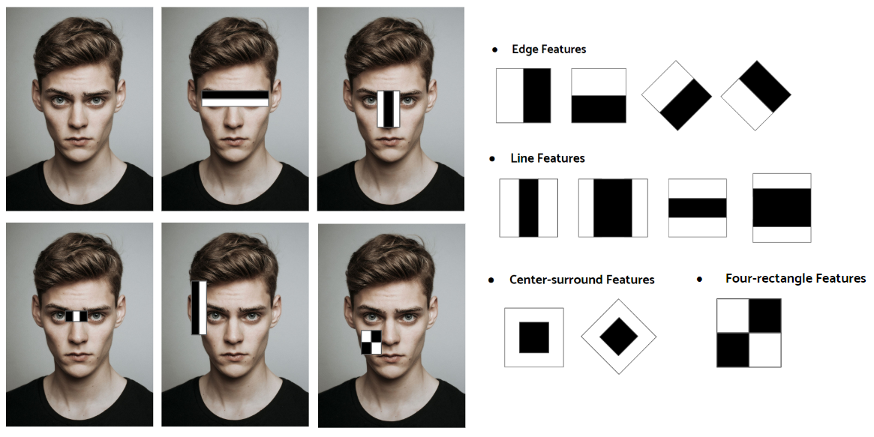
METHODOLOGY
Face Detection Using Haar-Cascades
A Haar wavelet is a mathematical ﬁction that produces square-shaped waves with a beginning and an end.
To analyse an image using Haar cascades, a scale is selected smaller than the target image.
It is then placed on the image, and the average of the values of pixels in each section is taken.
If the diﬀerence between two values pass a given threshold, it is considered a match.
Face Recognition and Detection

Slide 9
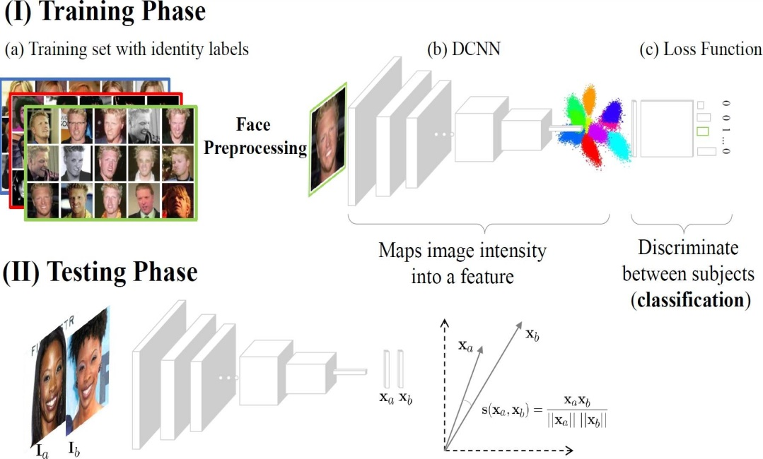
HOW TO TRAIN IMAGE?
Face Recognition and Detection

Slide 10
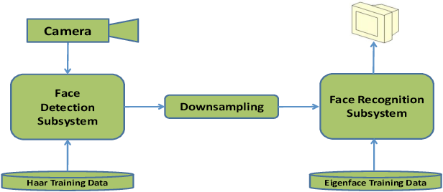
REPORT ANALYISIS
Face Recognition and Detection

Slide 11
IMPLEMENTATION AND RESULT
Face Recognition and Detection

Slide 12
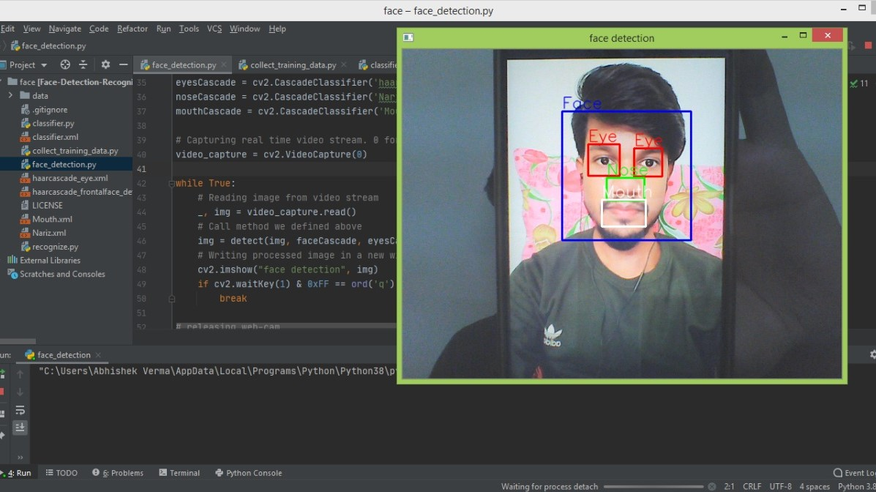
LAYOUT
Face Recognition and Detection

Slide 13
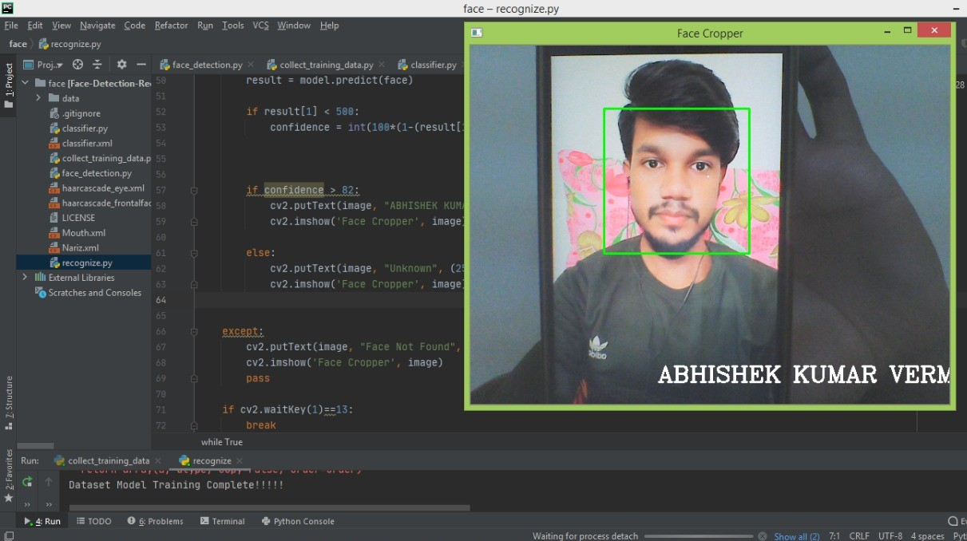
LAYOUT
Face Recognition and Detection

Slide 14
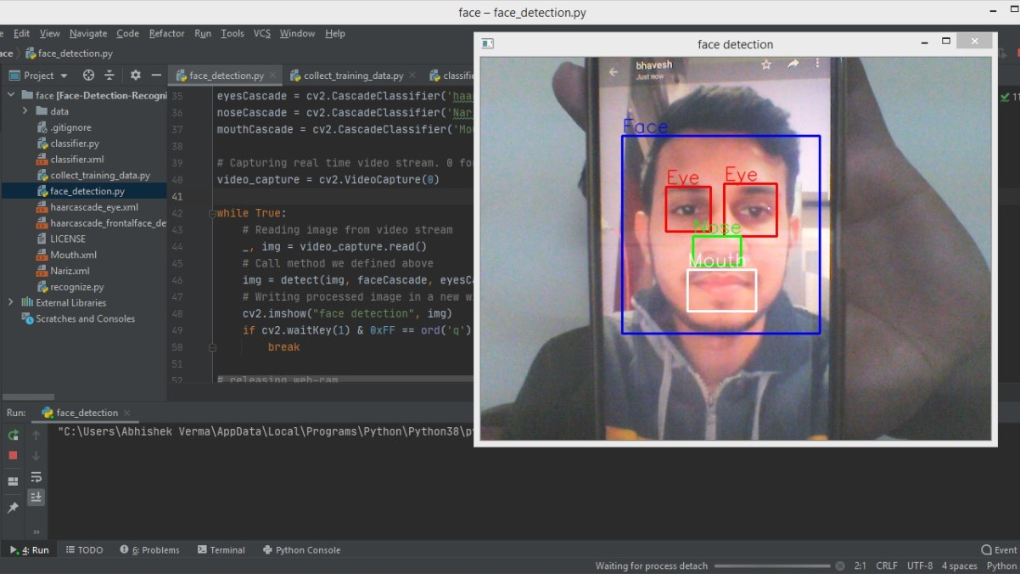
LAYOUT
Face Recognition and Detection

Slide 15
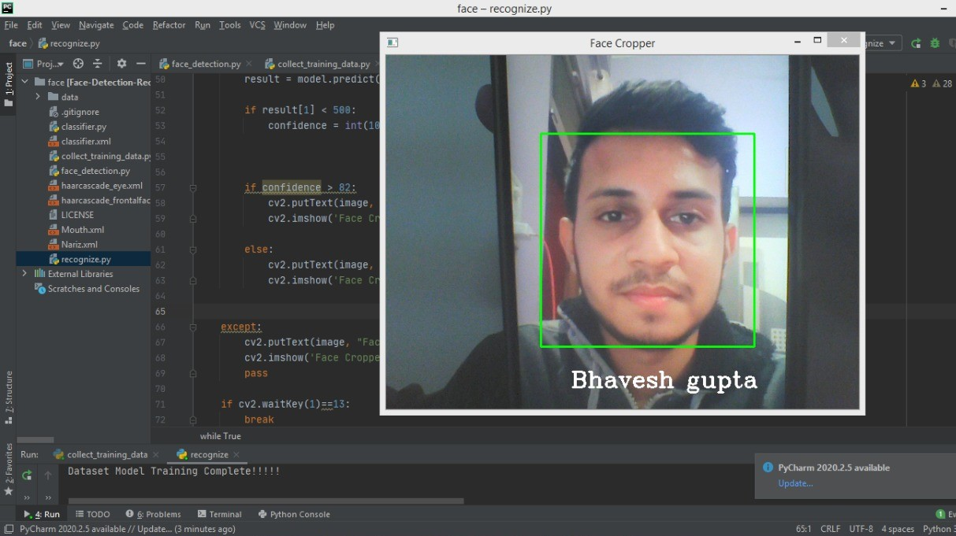
LAYOUT
Face Recognition and Detection

Slide 16
FUTURE SCOPE
Who Uses Facial Recognition?
Mobile phone makers in products. Apple first used facial recognition to unlock its iPhone X, and continues with the iPhone XS
Colleges in the classroom. Facial recognition software can, in essence, take roll. If you decide to cut class, your professor could know. Don’t even think of sending your brainy roommate to take your test.
Social media companies on websites. Facebook uses an algorithm to spot faces when you upload a photo to Its platform
Businesses at entrances and restricted areas.
Religious groups at places of worship.
Airlines at departure gates. You might be accustomed to having an agent scan your boarding pass at the gate to board your flight. At least one airline scans your face.
Face Recognition and Detection
Notes:
Who uses facial recognition?

Slide 17
Conclusion
machines are able to automatically verify identity information for secure transactions, for surveillance and security tasks, and for access control to buildings etc. These applications usually work in controlled environments and recognition algorithms can take advantage of the environmental constraints to obtain high recognition accuracy.
To achieve this goal computers must be able to reliably identify nearby people in a manner that fits naturally within the pattern of normal human interactions
They must not require special interactions and must conform to human about when recognition is likely.
Face Recognition and Detection

Slide 18
Thank You
Face Recognition and Detection

